Slide 1

Housekeeping
Module 12 – Trauma and Suicide Informed
Please mute yourself if you are not speaking.
Feel free to include your pronouns in your Zoom Name.
Use Zoom reaction tools, chat box, hands up, etc.
Be prepared to have video on at all times; as such, please be appropriately dressed and limit distractions.
Contribute to the conversations out loud and in the chat box.
If someone has already shared what you were going to say, lower your hand and put “agree” in the chat.
Notes:
COORDINATOR
Read out Housekeeping slide.

Slide 2
Expectations
Module 12 – Trauma and Suicide Informed
Arrive on time.
Help us create a confidential, non-judgmental space (no screenshots or recordings).
Please keep your phones on silent.
Avoid cross-talk and side-talk.
Learn from each person’s perspective.
Language – please bring new language to us as we recognize that language is ever-changing.
Have fun!
From the group:
[ADD PARTICIPANT ADDITIONS, IF ANY]
Notes:
COORDINATOR
Read out Expectations slide.

Slide 3
Trauma and Suicide-Informed
Module 12
Notes:
Trainer Manual
Module 12: Trauma and Suicide Informed © 2023 PeerWorks
This training program is designed to be accessible to all trainers, and ensure that all participants receive the same quality of education regardless of specific trainers’ background and experience.
This manual is a living document and should be understood as a set of guidelines, not as a fixed script. Feel free to adapt the language to your style of presentation. We also recognize that language is always changing; please update terminology when necessary. The synchronous sessions should be dynamic, engaging experiences.
TRAINER
Welcomes everyone and states the topic of today’s module.

Slide 4
Land Acknowledgement
Module 12 – Trauma and Suicide Informed
[ADD TRAINER’S LAND ACKNOWLEDGEMENT HERE]
Notes:
TRAINER’S LAND ACKNOWLEDGEMENT

Slide 5

Icebreaker Activity
Module 12 – Trauma and Suicide Informed
What is your name?
What is something that gives you hope?
Notes:
TRAINER
“What is something that gives you hope?”
As the trainers, feel free to go first. Keep it brief and thank people for sharing.

Slide 6
Module Overview
Module 12 – Trauma and Suicide Informed
In Module 12 we will be discussing becoming Trauma and Suicide Prevention informed.
This session will focus on the knowledge we need to develop to become competent Peer Supporters. We will consider approaches and resources related to becoming trauma informed and suicide prevention informed.
The purpose of this module is not to gain expert knowledge, but to develop a solid foundation and learn where to further develop our skills and our knowledge base.
Notes:
TRAINER
“A person who is informed shows that they are knowledgeable about a topic. Their demonstrated knowledge is based on a solid understanding of facts related to the topic and may be gained through learning and/or experience.
While specific knowledge acquired by a Peer Supporter will be influenced by the particular role and setting within which they are affiliated, we recognize that there are core knowledge areas that are important for all Peer Supporters to become informed about regardless of the setting in which they fulfill their role.
We have identified the core knowledge areas as: Trauma, Suicide Prevention, Substance Use and Eating Disorders. The intention within this module is to name and introduce each of the topic areas. To provide you with beginning knowledge and support you in identifying the initial steps to becoming informed. The onus is on you as a Peer Supporter to take the next steps in becoming informed.”
Read the Module Overview and Learning Objectives out loud or invite a participant to read it out loud.

Slide 7
Learning Objectives
Module 12 – Trauma and Suicide Informed
Through the successful completion of Module 12, you will be able to:
Become familiar with issues related to trauma and suicide that may arise during a Peer Supporter/Peer relationship.
Identify strategies for Peer Supporters to further expand their knowledge base on issues of Trauma and Suicide Prevention.
Employ a trauma-informed approach to Peer Support.
Notes:
TRAINER
Read the Module Overview and Learning Objectives out loud or invite a participant to read it out loud.

Slide 8
Trauma Informed
Module 12 – Trauma and Suicide Informed
Trauma can be defined as a deeply distressing experience OR the emotional shock following a stressful event.
ACE – Adverse Childhood Experiences are a main source of trauma. These can include: violence, poverty, discrimination, sexual/physical/emotional abuse, and neglect.
It is important for us to recognize and acknowledge that the experience of Trauma amongst Peers is universal – the rule rather than the exception. The vast majority of Peers, including ourselves, have experienced some form of trauma.
Notes:
TRAINER
Read out the slide.
Ask: “What is the difference between trauma and crisis?”
Crisis is an acute experience, while trauma can be an acute experience, as well as the lasting impact of that experience.

Slide 9

Module 12 – Trauma and Suicide Informed
“Trauma is the lasting emotional response that often results from living through a distressing event. Experiencing a traumatic event can harm a person’s sense of safety, sense of self, and ability to regulate emotions and navigate relationships. Long after the traumatic event occurs, people with trauma can often feel shame, helplessness, powerlessness and intense fear.”
https://www.camh.ca/en/health-info/mental-illness-and-addiction-index/trauma
Notes:
TRAINER
This is a definition from the Centre for Addiction and Mental Health, which is a psychiatric hospital in Toronto and ten community resources across Ontario.
“When thinking of Trauma, consider all of our experiences related to recovering our mental health and wellbeing. Consider experiences of stigmatization and discrimination as well as experiences related to receiving treatment and learning how to manage our mental health. Combine these with the prevalence of sexual and physical abuse and post-traumatic stress disorder within our Peer group.”
Open the room up to any questions.

Slide 10
Signs and Symptoms
Module 12 – Trauma and Suicide Informed
Many of the signs and symptoms of trauma mirror the signs and symptoms of a mental health issue.
These may include: fear, agitation, resignation, eating disorders, lack of motivation, low self-esteem, dissociation, nightmares, auditory hallucinations, numbness, self-harming, depression, lack of trust, addiction, self-deprecation, anxiety, aggression, flashbacks, and poor judgment.
Post-traumatic stress disorder (PTSD) is a mental health condition that's triggered by a terrifying event — either experiencing it or witnessing it.
Notes:
TRAINER
Ask someone to read out the slide.

Slide 11
Re-traumatization
Module 12 – Trauma and Suicide Informed
Re-traumatization is any situation or environment that resembles an individual’s trauma literally or symbolically, which then triggers difficult feelings and reactions associated with the original trauma.
What is defined as ‘traumatic’ is in the eye of the beholder. Some general examples of the kinds of experiences that may re-traumatize a person recovering their mental health and well-being include:
Loss of control and choice
Lack of safety and/or privacy
Hospitalization
Seclusion and restraint
Notes:
TRAINER
“Becoming Trauma informed includes being sensitive to the vulnerabilities or triggers of Peers who have experienced trauma so that you can, as a Peer Supporter, approach the Peer in ways that are supportive and as much as possible avoid contributing to re-traumatization.”
Invite someone to read out the slide
“Re-traumatization is often unintentional. There are some “obvious” practices that could be re-traumatizing such as the use of restraints or isolation, however, less obvious practices or situations that involve specific smells, sounds or types of interactions may cause individuals to feel re-traumatized.
Individuals with multiple trauma experiences often exhibit a decreased willingness to engage in treatment.
Re-traumatization may also occur with individuals who have history of historical, inter-generational and/or a cultural trauma experience.”

Slide 12
Notes:
TRAINER
“This is a chart by the Institute on Trauma and Trauma-Informed Care from 2015.
It discusses how a person can be re-traumatized from both a systemic perspective (for instance, the procedures of a hospital) or a relationship (such as a one-on-one relationship). The left side are the systemic impacts, and the right side are the personal impacts.”

Slide 13
Trigger Warnings / Content Warnings
Module 12 – Trauma and Suicide Informed
A trigger warning is a statement made before sharing potentially disturbing or upsetting content.
That content might include graphic references to topics such as sexual abuse, self-harm, violence, eating disorders, and so on, and can take the form of an image, video clip, audio clip, or piece of text.
Notes:
TRAINER
Invite someone to read out the slide or read it yourself.
“In your work with a Peer, they might state that they can be “triggered” or have adverse responses to certain discussions or terminology. This is especially important to keep in mind when sharing your own personal experiences.”

Slide 14
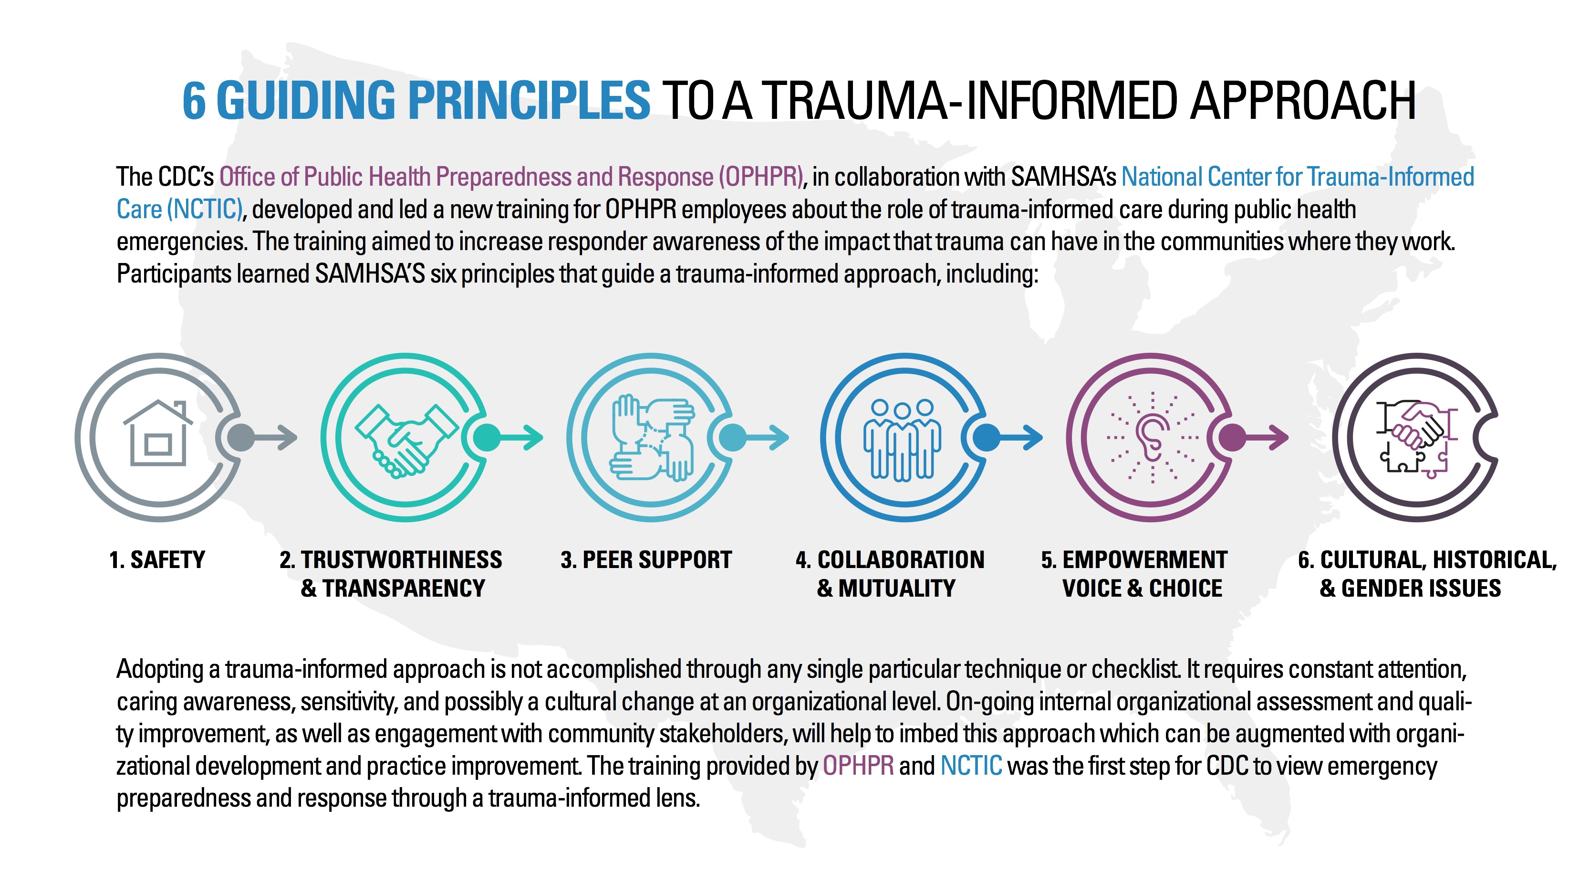
Notes:
TRAINER
“This is a chart created by the CDC and SAMSHA on becoming more trauma-informed. As you can see, Peer Support is one of the 6 Guiding Principles to becoming trauma-informed, and the other 5 are also part of the work that we do.”
Read out the 6 Guiding Principles.
It isn’t important to read out the rest of the slide, but you can read out “adopting a trauma-informed approach is not accomplished through any single particular techniques or checklist. It requires constant attention, caring awareness, sensitively, and possibly a cultural change at an organizational level.”

Slide 15
What’s wrong with you → What happened to you?
Module 12 – Trauma and Suicide Informed
What are some services, resources, supports within your community that may be beneficial to a Peer who has experienced trauma?
What are next steps you can take to be more trauma informed?
How might we support a peer who has been retraumatized?
Notes:
TRAINER
“Some of the ways we can become more trauma-informed can be found in our language, such as the example of swapping out “what’s wrong with you?” with “what happened to you?”
Are there any other things you are currently doing in your work to be more trauma-informed?”
Raise the questions on the slide to the participants and invite them to share their experiences.
When discussing how to support a Pere who has been retraumatized, refer back to the crisis module and creating an action plan.

Slide 16
Vicarious/Secondary Trauma
Module 12 – Trauma and Suicide Informed
Vicarious trauma is an occupational challenge for people working and volunteering in the fields of victim services, law enforcement, emergency medical services, fire services, and other allied professions, due to their continuous exposure to victims of trauma and violence.
This work-related trauma exposure can occur from such experiences as listening to individual clients recount their victimization; looking at videos of exploited children; reviewing case files; hearing about or responding to the aftermath of violence and other traumatic events day after day; and responding to mass violence incidents that have resulted in numerous injuries and deaths.
Notes:
TRAINER
Read out the definition for vicarious/secondary trauma.
Open it up to any questions/experiences.
Note: it is very important to do self-care, be self-aware, create boundaries, and debrief. These are some of the things that can help us protect ourselves from vicarious trauma.
At this point you should be about halfway through the allotted time.

Slide 17
Suicide Informed
Module 12 – Trauma and Suicide Informed
While the suicide rate for Canadians is 15/100,000 people, rates are higher among specific groups including people with a mental illness. More than 90 percent of suicide victims have a psychiatric diagnosis and suicide is the most common cause of death for people with schizophrenia.
Men take their lives at a rate four times higher than women. Studies indicate that there is a correlation between a history of sexual abuse and suicide attempts and the relationship is twice as strong for women as for men. Suicide accounts for 24% of all deaths among 15-24 year olds and 16% among 16-44 year olds.
Notes:
TRAINER
These are some statistics from the Canadian Mental Health Association on Suicide rates in Canada. Invite someone to read it out or read it out yourself.

Slide 18
Module 12 – Trauma and Suicide Informed
LivingWorks Education are leaders in the development and delivery of Suicide Prevention Programs.
Their primary focus is to support helpers in developing competencies to intervene with persons at risk of suicide. LivingWorks Suicide Prevention Programs have become the standard within health care and include:
ASIST – Applied Suicide Intervention Skills Training
ASIST is a two-day, interactive, practical and practice-oriented workshop intended to increase the comfort, confidence and competence of caregivers in preventing the immediate risk of suicide.
LivingWorks has a variety of training, including a one-hour online course in recognizing the signs of suicide and taking action.
https://www.livingworks.net/
Notes:
TRAINER
Read out the description of LivingWorks.

Slide 19
LivingWorks Core Principles
Module 12 – Trauma and Suicide Informed
Suicide is a community health problem.
Thoughts of suicide are understandable, complex and personal.
Suicide can be prevented.
Help-seeking is encouraged by open, direct and honest talk about suicide.
Relationships are the context of suicide intervention.
Intervention should be the main suicide prevention focus.
Cooperation is the essence of intervention.
Intervention skills are known and can be learned.
Large numbers of people can be taught intervention skills
Notes:
TRAINER
Read out the core principles of LivingWorks.

Slide 20
Guidelines for Sharing Experiences
Module 12 – Trauma and Suicide Informed
Avoid detailed descriptions of methods and locations that can sensationalize suicide.
Avoid statements of blame that can be stigmatizing.
Avoid statements that could glamourize or romanticize suicide.
Speak to the complexity of suicide, highlighting that multiple factors are at play and suicide is not a simplistic reaction to life’s difficulties.
Acknowledge that sharing can be difficult.
Emphasize the recovery and healing process
Let people know that recovery from suicidal thoughts and behaviours, as well as from suicide loss, is possible!
Notes:
TRAINER
Read out the guidelines for sharing experience with suicide.
These guidelines are drawn from https://www.suicideinfo.ca/resource/guidelines-for-sharing-experiences-with-suicide/
Reiterate the bolded guidelines, as they can provide hope and save lives.

Slide 21
Resources
Module 12 – Trauma and Suicide Informed
Crisis and Trauma Resource Institute https://ca.ctrinstitute.com/resources/
Trauma Informed Care Implementation Resource Centre https://www.traumainformedcare.chcs.org
Canadian Association for Suicide Prevention https://suicideprevention.ca/
Crisis Services Canada https://988.ca/
Centre for Suicide Prevention (Canadian) https://www.suicideinfo.ca/
LivingWorks https://www.livingworks.net/
PeerWorks’ Trauma-Informed Peer Support Webinar by Keely Phillips https://vimeo.com/432935662
Centre for Suicide Prevention Workshops: https://www.suicideinfo.ca/workshops
  Looking forward (children and youth)
  Small talk (warning signs in children)
  Walk with me (indigenous suicide bereavement)
  Suicide to hope (caregivers of those at risk)
  River of life (caregivers of indigenous youth)
Notes:
COORDINATOR
Read out the resources for this module and bring the conversation back to the opening discussion of hope and self-care.

Slide 22
Group Check-Out
Module 12 – Trauma and Suicide Informed
Notes:
TRAINER
This was a heavy topic that has previously had an emotional impact on our participants, so we wanted to end with a “check-out” question and encourage everyone to take time for self-care.

Slide 23
For Next Time
Module 12 – Trauma and Suicide Informed
Our next Module is on being Substance Use and Eating Disorder informed.
Please read the stories shared by David and Suzanne.
Notes:
COORDINATOR
Read out the homework. Thank everyone for their participation. Invite anyone to stay afterwards if they want to talk about anything, they don’t have to take those feelings/thoughts with them.

Slide 24
Thank You
Notes:
TRAINER
Thank everyone for their time and ask if anyone has any final comments or questions that they want to bring forward.

